Slide 1

Reliability Evaluation of Smart Grid including the Impact of Cyber-physical Interactions
Chanan Singh
Regents Professor
Department of Electrical and Computer Engineering
Texas A&M University
College Station, TX 77843, USA
DLP : Bangkok, Dec 14, 2017

Slide 2
Introduction
Modern power systems are integration of
  Physical part, or primary part consisting of current carrying components for power delivery and
  Cyber part or secondary part consisting of monitoring, computing, communication and protection systems.
Human interface - power systems are not fully automated.

Slide 3
Introduction
Complexity is increasing with more monitoring, control and communications functions.
Sources of failure:
  physical components ( power/current carrying),
  failures in cyber network – hard and soft,
  human failures.
Contemporary power system reliability methods have focused almost entirely on the failure of physical components.

Slide 4
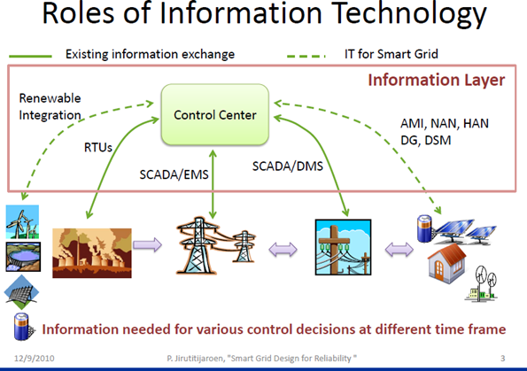

Slide 5
Emerging Power Systems
Power systems of the future are emerging to be different.
Two major factors contributing to this change:
  Large penetration of renewable energy sources
  Increasing complexity of cyber part.
Installation of hardware for interactive relationship between the supplier and consumer will add to complexity and interdependency between the cyber and physical parts.
Complexity and interdependency will introduce more sources of problems and make reliability analysis more challenging but also more essential.

Slide 6
Cyber-Physical Reliability vs Security
  Cyber Security: Studies deliberate cyber attack scenarios, consequences, and prevention or mitigation strategies.
  Cyber Reliability: Studies intrinsic failure modes of cyber related components and their impact on power system reliability.
  Ultimately both impact the reliability of power supply but the two may require different modeling and methodology.

Slide 7
Need for Reliability Analysis
Think before you act.
Analyze before you construct or implement.
Analysis at the planning and design stage leads to cost effective decisions that assure appropriate levels of reliability.

Slide 8
Analysis: Rule based vs Model Based
Rule based or deterministic indicators of reliability reflect postulated conditions.
Not directly indicative of electric system reliability and not responsive to most parameters which influence system reliability performance.
Therefore are of limited value for choosing between planning alternatives and rational decision making.
Their implementation is, however, simple and requires little data.

Slide 9
Rule Based vs Model Based
  Model based probabilistic indicators directly reflect the uncertainty which is inherent in the power system reliability problem.
  Have the capability of reflecting the various parameters which can impact system reliability.
  Therefore, probabilistic indices permit quantitative evaluation of system alternatives through direct consideration of parameters which influence reliability.
  This capability accounts for the increasing popularity and use of probabilistic indices.

Slide 10
Current Techniques: Dimensions of Their Development
System coverage: What part of the system is modeled.
Solution approaches:
  What models are used and
  the mathematical methods employed for their solution.

Slide 11
Level of System Coverage
Generating capacity reliability evaluation(HL1): basic objective is to determine adequacy of generation to meet demand with a given probability.
  Single area: Transmission assumed capable of transporting power from generation to load. Conceptually all generation and load in an area assumed connected to one bus.
  Multi-area: Inter-area tie line constraints are considered. Intra-area constraints considered only indirectly.

Slide 12
Single Area & Multi-Area Models
Single Area Model
Multi Area Model

Slide 13
Level of System Coverage
Composite system reliability evaluation(HL2): joint treatment of generation and bulk transmission.
  Constraints imposed by the capacity and impedance of transmission lines are considered.
  Voltage constraints may also be considered
Distribution system reliability(HL3): given the reliability at distribution substation, determine the reliability at customer level.
Special topics: reliability of protection systems and their impact on system reliability.

Slide 14
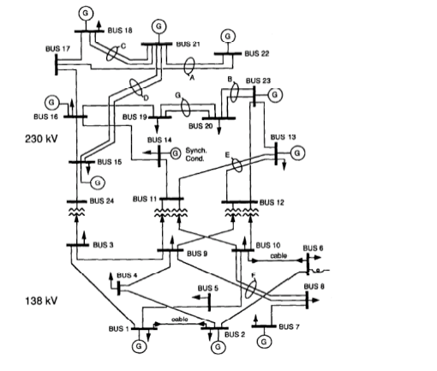
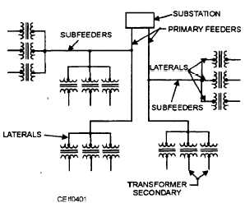
Composite System & Distribution System
Composite System Model
Distribution System

Slide 15
Solution Approaches in Power System Reliability Evaluation
Analytical methods: mostly used in single, multi-area and distribution system models.
Monte Carlo simulation; mostly used in multi-area and composite system models.
Intelligent search techniques: still in development stage for either increasing the efficiency of analytical or simulation or providing an alternative to Monte Carlo simulation.

Slide 16
Solution Approaches
Hybrid: mixing of different approaches for increased flexibility and strength.
Two of assumptions running through the developed models and methods :
  independence of components.
  cyber part is perfectly reliable and always functions as it should.

Slide 17
A General Schematic

Slide 18
System Models
System model complexity depend upon the intended application.
For single area studies the model is fairly simple unless operating considerations are included.
For multi-area studies the system model is more complex.
Presently composite level represents the highest level of complexity.
  Even at this level, complicating issues like the impact of protective relay malfunctions is generally excluded.
  Load is assumed forecast and its responsiveness to market conditions and type of generation available is not modeled in detail.

Slide 19
State Identification and Selection
Not possible to consider all system states because of dimensionality issue.
Analytical methods try to meet challenge of dimensionality by state merging, truncation and implicit enumeration.
Monte Carlo simulation meets this challenge by sampling.
Recently emerging intelligent search techniques, focus is on identifying dominant failure states.

Slide 20
Classification of States

Slide 21
State Evaluation
In any method, the selected state needs to be evaluated to determine if the objectives of the system are satisfied.
This may be simple addition or subtraction.
This may need a transportation type model.
Or more time consuming DC or AC power flow model.

Slide 22
Monte Carlo Simulation
Non-sequential or sampling.
Sequential simulation.

Slide 23
Non-sequential Simulation
Sample component states proportional to their probabilities.
Construct system states from component states.
Evaluate system states.
Estimate indices.

Slide 24
Sequential Monte Carlo Simulation
- Creating possible system history
Step 1: Set the initial state of all components as UP and set the simulation time t = 0.
Step 2: For each component, draw a random decimal number between 0 and 1 and using random number and transition rate determine the time to next transition of each component.

Slide 25
Creating possible system history
Step 3: Find the minimum time to transition, change the state of the corresponding component q, and update the total time.
Step 4: Change the q^{th} component’s state accordingly.
Step 5: Perform a network power flow analysis to assess system operation states. Update system-wide reliability indices.
Repeat steps 2–5 until convergence is achieved

Slide 26
Observations
Two parts of a power system: Current carrying part and cyber part.
To this day, power system reliability methods have focused primarily on current carrying part.
Dimensionality and complexity are two major challenges in power system reliability analysis.
Dimensionality arises from a large number of components and combination of possible states.
Complexity arises from complex interrelationship between components and modification of system behavior by operating strategies.

Slide 27
Observations
Capacity and admittance of components distinguish power system from some other systems and increase complexity.
Demarcation of power system into hierarchical levels has been beneficial for guiding the development of reliability methods.
But it has also narrowed its focus leading to ignoring interfaces outside this framework.

Slide 28
Future of Power Systems
Power systems of the future will be different from past.
Two major factors contributing to this change:
  Large penetration of renewable energy sources
  Smartization of grid backed by federal government.
Installation of hardware for interactive relationship between the supplier and consumer will add to complexity and interdependency between the cyber and physical parts.
Complexity and interdependency will introduce more sources of problems and make reliability analysis more challenging.

Slide 29
Possible Approaches to Reliability Modeling for Future Power Systems
Complexity and dimensionality make reliability analysis of the entire system in a single step computationally intractable.
Even for the current carrying part alone, it is not computationally efficient to model all the components distinctly and simultaneously.
Some consolidation at the subsystem level is generally necessary.
Also it is necessary to move sequentially in analysis.

Slide 30
Categories of Impact of Cyber Failures
Local impact
Degradation impact
Catastrophic impact

Slide 31
Modeling Local Effects of Cyber Failures
More interested in continuity of signals rather than capacity of links
Analytical methods like cut-sets or Monte Carlo could be used.

Slide 32
Degradation Effects of Cyber Failures
Degrade the ability of system for optimal use of current carrying part.
More serious than the local effects
Perhaps still could use continuity criterion making state evaluation less time consuming.

Slide 33
An Example of Local and Degradation Effects

Slide 34
Example of Smart Homes Helping Smart Grid Functionality
Creating Spinning Reserve in Day Ahead Market
Using In Ground Swimming Pools

Slide 35
How to Gain Flexibility?
Case of the reserve market
Through conventional power plants scheduling
  Advantage: Almost a firm capacity
  Disadvantage:
    Deliverability
    Constraint on the unit capacity
By using the flexibility of the demand itself
  Advantage: Geographical diversity
  Disadvantage:
    How much is firm capacity?
    Customer’s comfort

Slide 36
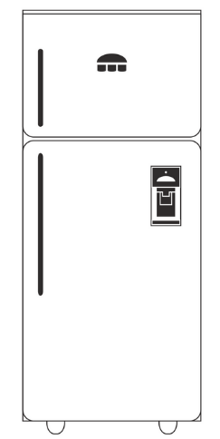
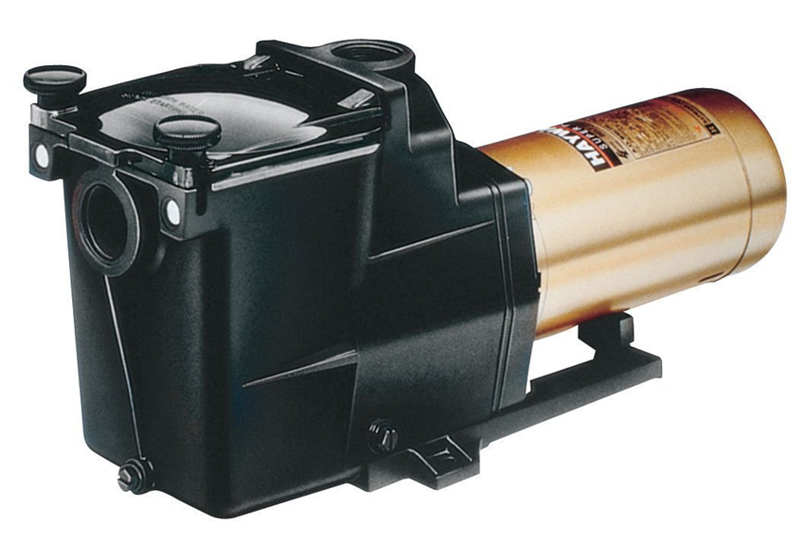
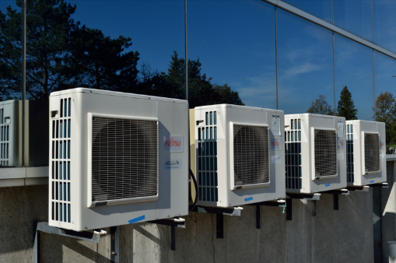
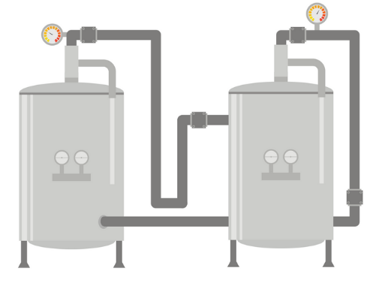
Flexibility Through Residential Demand
Why swimming pool pumps was chosen by us?
Comfort
Privacy
Comfort
Privacy

Slide 37
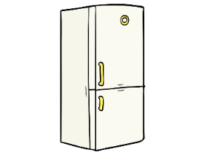


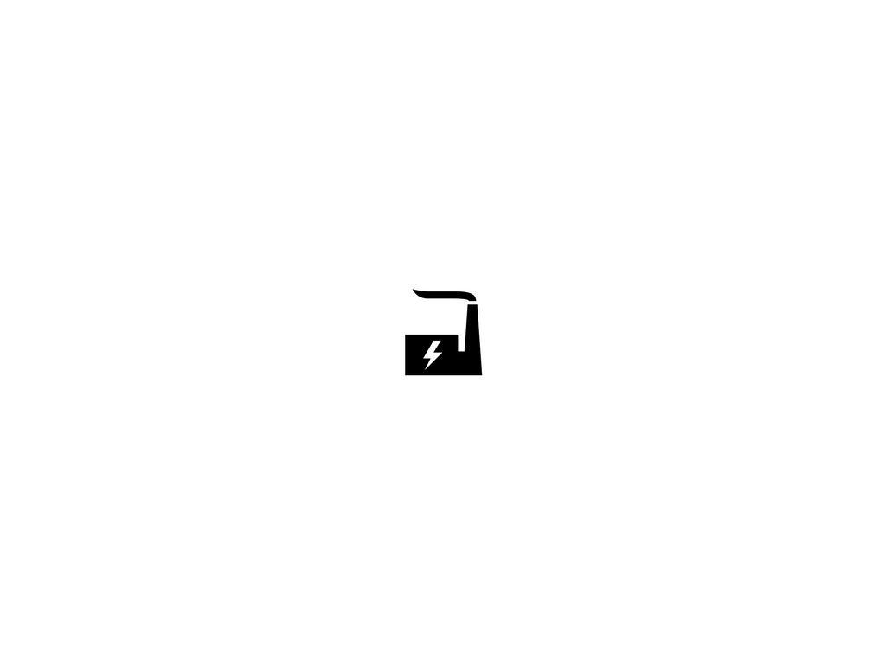
Capacity They Can Provide:
1-2 kW Per Pump
4-14 Hours Daily
=
10-20
≈1 Million pool pumps in TX
≈1.5 GW flexible capacity
© 2017 M. Sadegh Modarresi

Slide 38

Benefits for the Customers:
Time is important for everyone.
The optimal hours a pool needs to be filtered changes daily as a function of:
    Weather temperature
    Usage of the pool
    Sunlight
Giving up the control will enhance the comfort of pool owners.

Slide 39

Benefits for the Aggregator:
Providing a part of their ancillary service mandate using pools.
Potentially participate in the spinning reserve market.
Energy arbitrage.
Capital investment? Benefits gained from this investment?

Slide 40







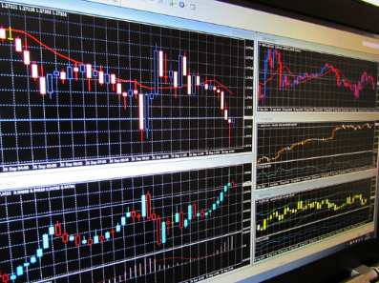



Inputs, Medium and Outcomes:
Customers
Aggregator
ISO

Slide 41
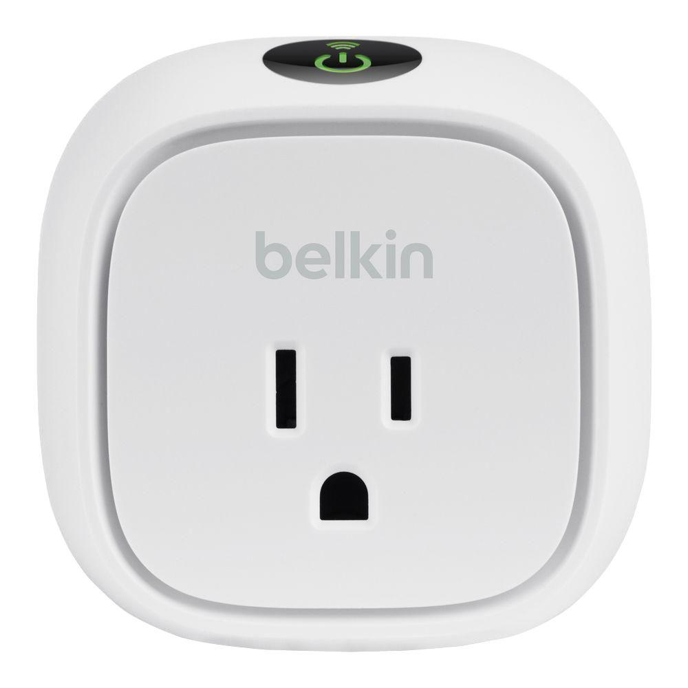

Control Device: as simple as a Wemo
Wemo switch enable users to control home electronics remotely.
Source of Wemo picture: http://www.belkin.com

Slide 42
Communication Between the IoT Switch and the Control Center
Source of image: M. S. Modarresi, L. Xie, and C. Singh “Reserves from Controllable Swimming Pool Pumps: Reliability Assessment and Operational Planning,” in 51st Hawaii International Conference on System Sciences (HICSS), January 2018.

Slide 43
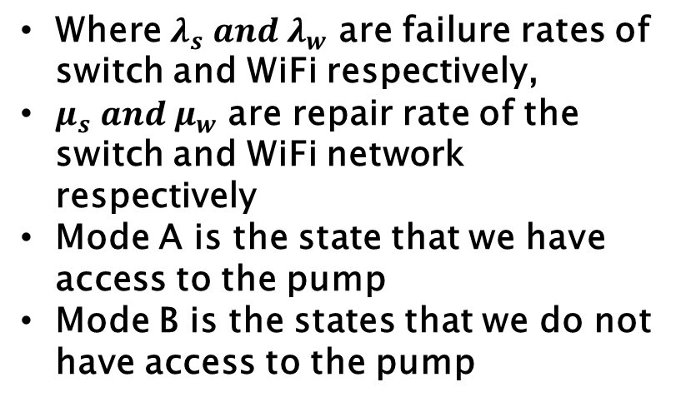
State Space Diagram of Switch and WiFi
Where $λ_{s}{ and λ}_{w}$ are failure rates of switch and WiFi respectively,
$μ_{s}{ and μ}_{w}$ are repair rate of the switch and WiFi network respectively
Mode A is the state that we have access to the pump
Mode B is the states that we do not have access to the pump
Source of image: M. S. Modarresi, L. Xie, and C. Singh “Reserves from Controllable Swimming Pool Pumps: Reliability Assessment and Operational Planning,” in 51st Hawaii International Conference on System Sciences (HICSS), January 2018.

Slide 44
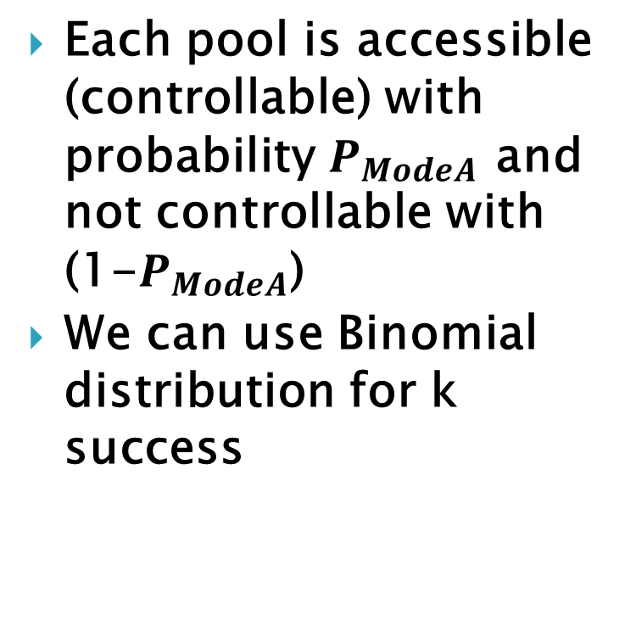
Probability distribution of k success
Each pool is accessible (controllable) with probability $P_{ModeA}$ and not controllable with (1-$P_{ModeA}$)
We can use Binomial distribution for k success

Slide 45
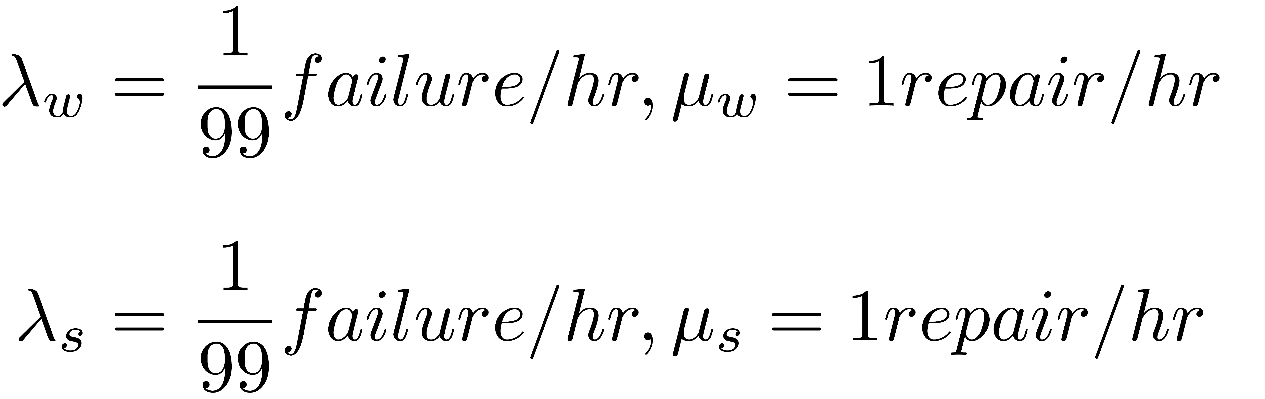
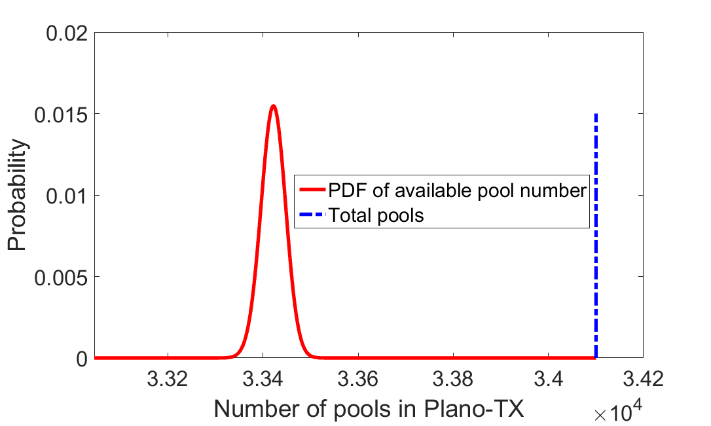
Probability Distribution of k Successes

Slide 46
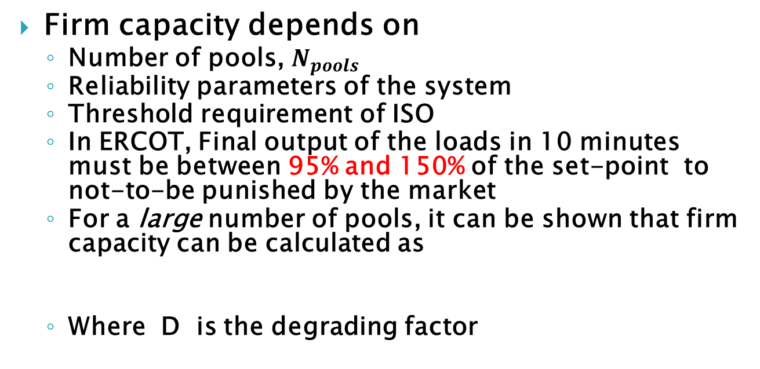
Scheduling the Pool Pumps for Operational Planning
Firm capacity depends on
  Number of pools, $N_{pools}$
  Reliability parameters of the system
  Threshold requirement of ISO
  In ERCOT, Final output of the loads in 10 minutes must be between 95% and 150% of the set-point to not-to-be punished by the market
  For a large number of pools, it can be shown that firm capacity can be calculated as
  Where D is the degrading factor

Slide 47
Catastrophic Effects
Stronger interaction between cyber and physical part and analysis is more complex.
In some situations the problem could be simplified by analyzing the cyber part and representing this through a relationship matrix.

Slide 48
Cyber- Physical Interaction
The concepts and approaches will be explained using an example of a substation.
The problems, however, extend across the entire grid.

Slide 49
Digital Substation as a Cyber-Physical System
Physical Components (Power-Carrying Components):
Transmission Lines
Power Transformers
Circuit Breakers
Buses
Cyber Components:
CTs/PTs
Merging Units
Process Bus
Ethernet Switches
Protection IEDs
An IEC 61850 based protection system for a 230-69 kV substation

Slide 50
More Detail on the Cyber
MU: Merging Unit
IED: Intelligent Electronic Device
HMI: Human Machine Interface

Slide 51
Protection Zone Division
Type | Fault Locations | Associated Circuit Breakers
Line | A | Breaker 1
 | B | Breaker 2
 | I | Breaker 9
 | J | Breaker 10
Transformer | E | Breakers 4, 6
 | F | Breakers 5, 7
Bus | C | Breakers 1, 3, 4
 | D | Breakers 2, 3, 5
 | G | Breakers 6, 8, 9
 | H | Breakers 7, 8, 10

Slide 52
How of Cyber-Physical Interdependency
Analysis:
Primary fault on Line A
*Other :
One or more components of MU1, Line Protection Panel, CB1 fail to operate. Or Process Bus is in delay state
Failure Modes | Physical Components Affected | Probability
Protection all good | Only Line A | 0.996957511
Process bus failed | Entire Substation | 0.000009132
Other* | Line A and Bus C | 0.003033357

Slide 53
Cyber-Physical Interdependency
Analysis: Primary fault on Line B
Physical Components Affected | Probability
Only Line B | 0.996957511
Entire Substation | 0.000009132
Line B and Bus D | 0.003033357
Analysis: Primary fault on Line I
Physical Components Affected | Probability
Only Line I | 0.996957511
Entire Substation | 0.000009132
Line I and Bus G | 0.003033357
Analysis: Primary fault on Line J
Physical Components Affected | Probability
Only Line J | 0.996957511
Entire Substation | 0.000009132
Line J and Bus H | 0.003033357

Slide 54
Cyber-Physical Interdependency
Analysis:
Primary fault on Transformer E
Physical Components Affected | Probability
Only E | 0.996942336
Entire Substation | 0.000009132
E and C | 0.000015174
E and G | 0.000015174
E, C, and G | 0.003018182

Slide 55
Cyber-Physical Interdependency
Analysis:
Primary fault on Bus C
Physical Components Affected | Probability
Only C | 0.996927163
Entire Substation | 0.000009132
A and C | 0.000015174
C and D | 0.000015174
C and E | 0.000015174
A, C, and D | 2.31*10⁻¹⁰
A, C, and E | 2.31*10⁻¹⁰
C, D, and E | 2.31*10⁻¹⁰
A, C, D, and E | 0.003018182

Slide 56
Representing Interdependency for Reliability Analysis
Cyber-Physical Interface Matrix (CPIM)
Line A | 0.9969575 | 0.0000091 | 0.0030334 | 0 | ……
Line B | 0.9969575 | 0.0000091 | 0.0030334 | 0 | ……
Line I | 0.9969575 | 0.0000091 | 0.0030334 | 0 | ……
…… | …… | …… | …… | …… | ……
Bus H | 0.9969272 | 0.0000091 | 0.0000152 | 0.0000152 | ……
Consequent Events Matrix (CEM)
Line A | Event-1 | Event-2 | Event-3 | Event-4
Line B
Line I
…… | …… | …… | …… | …… | ……
Bus H

Slide 57
System-wide Reliability Evaluation
Composite system reliability evaluation with the use of cyber-physical interface matrix
Physical Part
Cyber Part

Slide 58
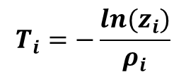
Monte Carlo Simulation
Composite system reliability evaluation with the use of cyber-physical interface matrix
Step 1: Set the initial state of all components as UP and set the simulation time t = 0.
Step 2: For each individual component, draw a random decimal number z_{i} between 0 and 1 to compute the time to the next event.
$$T_{i}=−\frac{ln(z_{i})}{ρ_{i}}$$
Depending on whether the i^{th} component is UP or DOWN, λ_{i} or µ_{i} is used in place of ρ_{i}

Slide 59

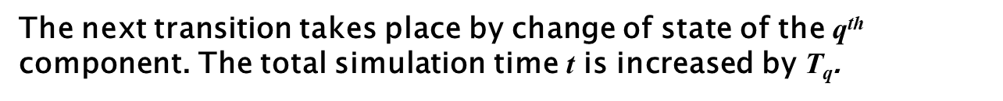
Monte Carlo Simulation
Composite system reliability evaluation with the use of cyber-physical interface matrix
Step 3: Find the minimum time, change the state of the corresponding component, and update the total time.
$$\text{T}\text{q}=\min\left\{T_{i}\right\}, 1≤i≤N$$
The next transition takes place by change of state of the q^{th} component. The total simulation time t is increased by $\text{T}\text{q}$.
t = t + T_{q}

Slide 60

Monte Carlo Simulation
Composite system reliability evaluation with the use of cyber-physical interface matrix
Step 4: Change the q^{th} component’s state accordingly.
For each component i
$$T_{i}=T_{i}−\text{T}\text{q}$$

Slide 61
Monte Carlo Simulation
Composite system reliability evaluation with the use of cyber-physical interface matrix
Step 5: If the state of the q^{th} component transits from UP to DOWN, which means a primary fault occurs on this component, then the cyber-physical interface matrix is used to determine if there are some subsequent failures causing more components out of service due to the cyber part’s malfunction.

Slide 62
Monte Carlo Simulation
Composite system reliability evaluation with the use of cyber-physical interface matrix
Draw another random decimal number y (0 < y ≤ 1)
Line A | 0.9969575 | 0.0000091 | 0.0030334 | 0 | ……
…… | …… | …… | …… | …… | ……
Transformer E | 0.9969423 | 0.0000091 | 0.0000152 | 0.0000152 | ……
…… | …… | …… | …… | …… | ……
Bus H | 0.9969272 | 0.0000091 | 0.0000152 | 0.0000152 | ……

Slide 63
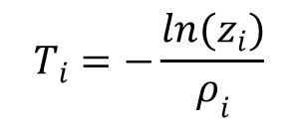
Monte Carlo Simulation
Composite system reliability evaluation with the use of cyber-physical interface matrix
How to determine the next transition time of Transformer E and Bus C?
$$T_{i}=−\frac{ln(z_{i})}{ρ_{i}}$$
For Transformer E, use µ_{i} in place of ρ_{i}
For Bus C, use µ_{i,exp} in place of ρ_{i}
µ_{i,exp} is an expedited repair rate, called switching rate

Slide 64
Monte Carlo Simulation
Composite system reliability evaluation with the use of cyber-physical interface matrix
Step 6: Perform a network power flow analysis to assess system operation states. Update system-wide reliability indices.
Repeat steps 3–6 until convergence is achieved.

Slide 65

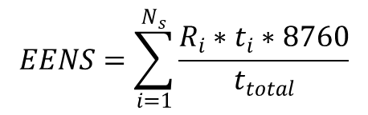
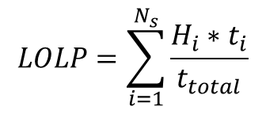
Monte Carlo Simulation
Composite system reliability evaluation with the use of cyber-physical interface matrix
When the simulation finishes, system-wide reliability indices can be obtained.
$$LOLP=\sum_{i=1}^{N_{s}}{\frac{H_{i}∗t_{i}}{t_{total}}}$$
$$EENS=\sum_{i=1}^{N_{s}}{\frac{R_{i}∗t_{i}∗8760}{t_{total}}}$$
(With the unit of MWh/year )
N_{s} | Total number of iterations simulated;
H_{i} | Equals 1 if load curtailment occurs in the i^{th} iteration; otherwise it equals 0;
t_{i} | Simulated time in the i^{th} iteration, with the unit of year;
t_{total} | Total simulated time, with the unit of year.
R_{i} | Load curtailment during the i^{th} iteration, with the unit of MW;
$$LOLE=LOLP∗8760$$
(With the unit of hours/year )

Slide 66
System Configuration
Illustrating the overall methodology on a standard test system
RBTS Test System
The size of this system is small to permit reasonable time for extension of cyber part and development of interface matrices.
But the configuration of this system is sufficiently detailed to reflect the actual features of a practical system
Buses 3–5 are extended with cyber configurations

Slide 67
System Configuration
Extend bus 3 of the RBTS Test System with substation protection configurations.
Physical part of the RBTS
Extension with cyber part in Bus 3

Slide 68
System Configuration
Extend bus 4 of the RBTS with substation protection configurations.
Physical part of the RBTS
Extension with cyber part in Bus 4

Slide 69
System Configuration
Extend bus 5 of the RBTS with substation protection configurations.
Physical part of the RBTS
Extension with cyber part in Bus 5

Slide 70
System Configuration
Generation Variation
Unit No. | Bus | Rating (MW) | Failure Rate ( /year) | MRT (hours)
1 | 1 | 40 | 6.0 | 45
2 | 1 | 40 | 6.0 | 45
3 | 1 | 10 | 4.0 | 45
4 | 1 | 20 | 5.0 | 45
5 | 2 | 5 | 2.0 | 45
6 | 2 | 5 | 2.0 | 45
7 | 2 | 40 | 3.0 | 60
8 | 2 | 20 | 2.4 | 55
9 | 2 | 20 | 2.4 | 55
10 | 2 | 20 | 2.4 | 55
11 | 2 | 20 | 2.4 | 55
Load Variation
The hourly load profile is created based on the information in Tables 1, 2, and 3 of the IEEE Reliability Test System*.
*IEEE Committee Report, “IEEE reliability test system,” IEEE Trans. Power App. and Syst., vol. PAS-98, no. 6, pp. 2047–2054, Nov./Dec. 1979.
Physical part of the RBTS

Slide 71
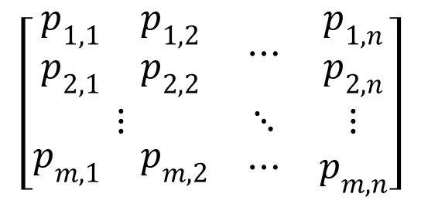
Stage 1: Substation Level Analysis
$$\left[\begin{matrix}\begin{matrix}p_{1,1} & p_{1,2} \\ p_{2,1} & p_{2,2}\end{matrix} & ⋯ & \begin{matrix}p_{1,n} \\ p_{2,n}\end{matrix} \\ ⋮ & ⋱ & ⋮ \\ \begin{matrix}p_{m,1} & p_{m,2}\end{matrix} & ⋯ & p_{m,n}\end{matrix}\right]$$
Analyze the cyber failure modes and consequent events and obtain the Cyber-Physical Interface Matrices (CPIM) for Buses 3-5.

Slide 72
Stage 1: Substation Level Analysis
Results: The CPIM and CEM of Bus 3
The Cyber-Physical Interface Matrix (CPIM) of Bus 3
Fault Location | Probabilities
Line 1 | 0.996899850569 | 0.000009132337 | 0.000027312491 | 0.000027312491 | 0.003036392112
Line 4 | 0.996899850569 | 0.000009132337 | 0.000027312491 | 0.000027312491 | 0.003036392112
Line 5 | 0.996899850569 | 0.000009132337 | 0.000027312491 | 0.000027312491 | 0.003036392112
Line 6 | 0.996899850569 | 0.000009132337 | 0.000027312491 | 0.000027312491 | 0.003036392112
The Consequent Event Matrix (CEM) of Bus 3
Fault Location | Events
Line 1 | 100000000000 | 100111000000 | 100100000000 | 100000000100 | 100100000100
Line 4 | 000100000000 | 100111000000 | 000110000000 | 100100000000 | 100110000000
Line 5 | 000010000000 | 100111000000 | 000011000000 | 000110000000 | 000111000000
Line 6 | 000001000000 | 100111000000 | 000001000100 | 000011000000 | 000011000100

Slide 73
Stage 1: Substation Level Analysis
Results: The CPIM and CEM of Bus 4
The Cyber-Physical Interface Matrix (CPIM) of Bus 4
Fault Location | Probabilities
Line 2 | 0.996899850569 | 0.000009132337 | 0.000027312491 | 0.000027312491 | 0.003036392112
Line 4 | 0.996899850569 | 0.000009132337 | 0.000027312491 | 0.000027312491 | 0.003036392112
Line 7 | 0.996899850569 | 0.000009132337 | 0.000027312491 | 0.000027312491 | 0.003036392112
Line 8 | 0.996899850569 | 0.000009132337 | 0.000027312491 | 0.000027312491 | 0.003036392112
The Consequent Event Matrix (CEM) of Bus 4
Fault Location | Events
Line 2 | 010000000000 | 010100110000 | 010000000010 | 010000010000 | 010000010010
Line 4 | 000100000000 | 010100110000 | 000100010000 | 000100100000 | 000100110000
Line 7 | 000000100000 | 010100110000 | 000100100000 | 000000100010 | 000100100010
Line 8 | 000000010000 | 010100110000 | 010000010000 | 000100010000 | 010100010000

Slide 74
Stage 1: Substation Level Analysis
Results: The CPIM and CEM of Bus 5
The Cyber-Physical Interface Matrix (CPIM) of Bus 5
Fault Location | Probabilities
Line 5 | 0.996899850569 | 0.000009132337 | 0.000027312491 | 0.000027312491 | 0.003036392112
Line 8 | 0.996899850569 | 0.000009132337 | 0.000027312491 | 0.000027312491 | 0.003036392112
Line 9 | 0.996899850569 | 0.000009132337 | 0.000027312491 | 0.000027312491 | 0.003036392112
The Consequent Event Matrix (CEM) of Bus 5
Fault Location | Events
Line 5 | 000010000000 | 000010011000 | 000010001000 | 000010000001 | 000010001001
Line 8 | 000000010000 | 000010011000 | 000000010001 | 000000011000 | 000000011001
Line 9 | 000000001000 | 000010011000 | 000000011000 | 000010001000 | 000010011000

Slide 75
Stage 2: Composite System Level Analysis
Utilize the results of the interface matrices, perform a Monte-Carlo simulation for the composite system, and obtain numerical results of system-wide reliability indices.

Slide 76
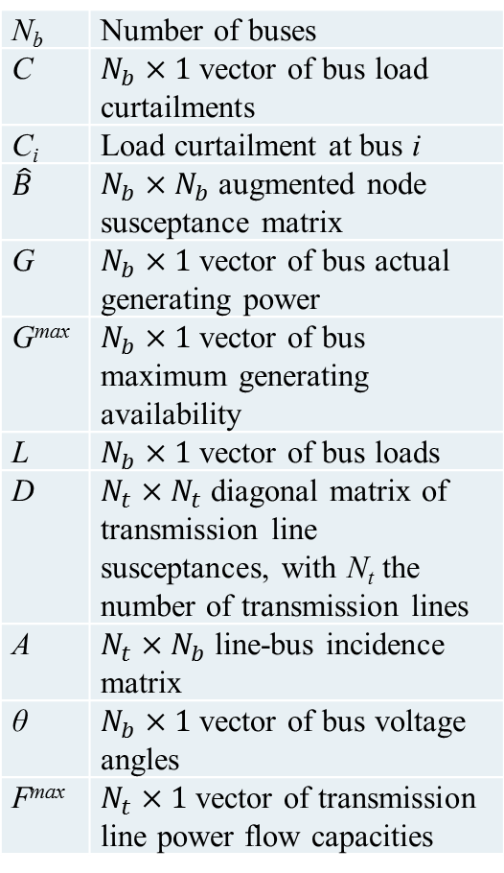
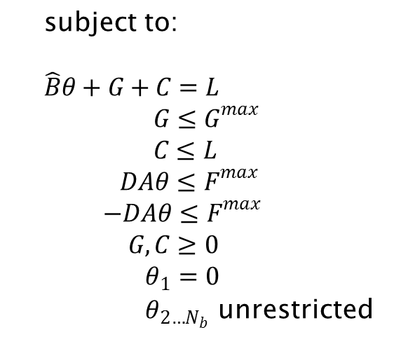
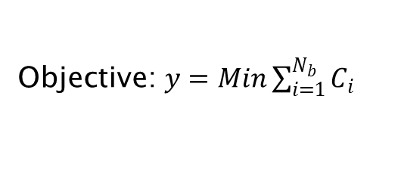
Stage 2: Composite System Level Analysis
N_{b} | Number of buses
C | $N_{b}×1$ vector of bus load curtailments
C_{i} | Load curtailment at bus i
$$\hat{B}$$ | $N_{b}×N_{b}$ augmented node susceptance matrix
G | $N_{b}×1$ vector of bus actual generating power
G^{max} | $N_{b}×1$ vector of bus maximum generating availability
L | $N_{b}×1$ vector of bus loads
D | $N_{t}×N_{t}$ diagonal matrix of transmission line susceptances, with N_{t} the number of transmission lines
A | $N_{t}×N_{b}$ line-bus incidence matrix
θ | $N_{b}×1$ vector of bus voltage angles
F^{max} | $N_{t}×1$ vector of transmission line power flow capacities
Objective: $y=Min\sum_{i=1}^{N_{b}}{C_{i}}$
subject to:
$\hat{B}θ+G+C=L$
$G≤G^{max}$
$C≤L$
$DAθ≤F^{max}$
$−DAθ≤F^{max}$
$G, C≥0$
$θ_{1}=0$
$θ_{2…N_{b}}$ unrestricted
Variables: θ, G, and C
Total number of variables: 3N_{b}

Slide 77
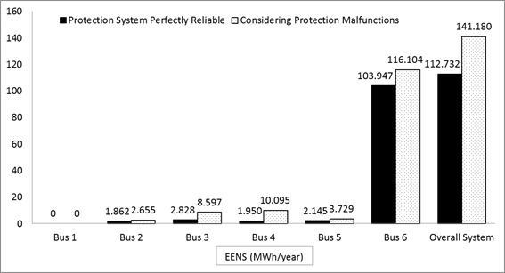
Stage 2: Composite System Level Analysis
Brief Results
Impact on Expected Energy Not Served (EENS)
 | EENS (MWh/year) |  | Δ
 | If protection systems are perfectly reliable | Considering protection malfunctions
Bus 1 | 0 | 0 | N/A
Bus 2 | 1.862 | 2.655 | 42.59%
Bus 3 | 2.828 | 8.597 | 204.00%
Bus 4 | 1.950 | 10.095 | 417.69%
Bus 5 | 2.145 | 3.729 | 73.85%
Bus 6 | 103.947 | 116.104 | 11.70%
Overall System | 112.732 | 141.180 | 25.24%

Slide 78
Modeling Cyber Link Failures

Slide 79
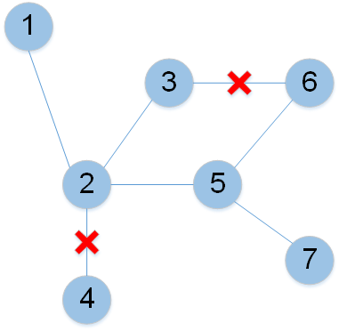
Modeling Cyber Link Failures
Two types of cyber link failures:
A link is unavailable due to packet delay resulting from traffic congestion or queue failure;
A link is physically damaged.
Failure type (b) is relatively rare and thus only failure type (a) is considered in this research

Slide 80
Modeling Cyber Link Failures
Reliability Data for Components
Cyber Component Names and Meanings
Component | Failure Rate (/year) | Mean Repair Time (h)
Circuit Breaker | 0.01 | 8
Merging Unit | 0.02 | 8
Ethernet Switch | 0.01 | 8
Line Protection Panel | 0.02 | 8
Component Name | Meaning
MU 1-1 | Merging Unit 1 at Substation 1
MU 1-2 | Merging Unit 2 at Substation 1
MU 1-3 | Merging Unit 3 at Substation 1
ES 1-1 | Ethernet Switch 1 at Substation 1
ES 1-2 | Ethernet Switch 2 at Substation 1
ES 1-3 | Ethernet Switch 3 at Substation 1
S1-L5 | Line 5 Protection Panel at Substation 1
S1-L1 | Line 1 Protection Panel at Substation 1
S1-L2 | Line 2 Protection Panel at Substation 1

Slide 81
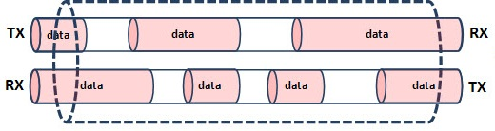
Modeling Cyber Link Failures
Cyber Component Names and Meanings
Component Name | Meaning
MU 1-1 | Merging Unit 1 at Substation 1
MU 1-2 | Merging Unit 2 at Substation 1
MU 1-3 | Merging Unit 3 at Substation 1
ES 1-1 | Ethernet Switch 1 at Substation 1
ES 1-2 | Ethernet Switch 2 at Substation 1
ES 1-3 | Ethernet Switch 3 at Substation 1
S1-L5 | Line 5 Protection Panel at Substation 1
S1-L1 | Line 1 Protection Panel at Substation 1
S1-L2 | Line 2 Protection Panel at Substation 1
For the link i, the time it takes for a packet to travel in the forward direction is a random variable denoted by t_{i.1}
For the reverse direction, the random time is denoted by t_{i.2}
For example:
Consider Link 7, the time it takes for a packet to travel from ES 1-1 to ES 1-2 is denoted by t_{7.1}
From ES 1-2 to ES 1-1, the time is denoted by t_{7.2}

Slide 82
Modeling Cyber Link Failures
Cyber Component Names and Meanings
Component Name | Meaning
MU 1-1 | Merging Unit 1 at Substation 1
MU 1-2 | Merging Unit 2 at Substation 1
MU 1-3 | Merging Unit 3 at Substation 1
ES 1-1 | Ethernet Switch 1 at Substation 1
ES 1-2 | Ethernet Switch 2 at Substation 1
ES 1-3 | Ethernet Switch 3 at Substation 1
S1-L5 | Line 5 Protection Panel at Substation 1
S1-L1 | Line 1 Protection Panel at Substation 1
S1-L2 | Line 2 Protection Panel at Substation 1
Consider the communication from MU 1-1 to S1-L1. There are two possible paths: 1-8-4 and 1-7-9-4.
$$p_{fail}=\operatorname{Pr}{[\left(t_{1.1}+t_{8.1}+t_{4.1}>T_{tsd}\right)}and (t_{1.1}+t_{7.1}+t_{9.1}+t_{4.1}>T_{tsd})]$$
where T_{tsd} is a predefined threshold delay value for the two paths.

Slide 83
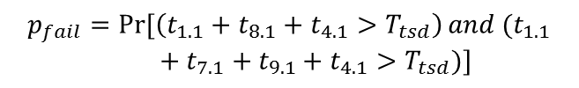
Modeling Cyber Link Failures
From MU 1-1 to S1-L1
$$p_{fail}=\operatorname{Pr}{[\left(t_{1.1}+t_{8.1}+t_{4.1}>T_{tsd}\right)}and (t_{1.1}+t_{7.1}+t_{9.1}+t_{4.1}>T_{tsd})]$$
Similarly, with any two components specified as the two ends of a communication path, the path failure probability can be computed from the cyber link level parameters

Slide 84
Modeling Cyber Link Failures
The detailed procedures are based on queueing theory and are beyond the scope of this research. These probabilities can be assumed directly at the path level.
From | To | Forward Path Failure Probability | Reverse Path Failure Probability
MU 1-1 | S1-L5 | 0.002 | 0.002
MU 1-1 | S1-L1 | 0.001 | 0.001
MU 1-1 | S1-L2 | 0.001 | 0.001
MU 1-2 | S1-L5 | 0.001 | 0.001
MU 1-2 | S1-L1 | 0.001 | 0.001
MU 1-2 | S1-L2 | 0.002 | 0.002
MU 1-3 | S1-L5 | 0.001 | 0.001
MU 1-3 | S1-L1 | 0.002 | 0.002
MU 1-3 | S1-L2 | 0.001 | 0.001

Slide 85
Modeling Cyber Link Failures
Results
The Cyber-Physical Interface Matrix
Primary Fault Location | Probabilities of Consequent Events
Line 1 | 0.9919152 | 0.0040342 | 0.0040342 | 0.0000164
Line 2 | 0.9919152 | 0.0040342 | 0.0040342 | 0.0000164
Line 3 | 0.9919152 | 0.0040342 | 0.0040342 | 0.0000164
Line 4 | 0.9919152 | 0.0040342 | 0.0040342 | 0.0000164
Line 5 | 0.9959494 | 0.0040506 | 0 | 0
Line 6 | 0.9959494 | 0.0040506 | 0 | 0
Line 7 | 0.9959494 | 0.0040506 | 0 | 0
Line 8 | 0.9959494 | 0.0040506 | 0 | 0
The Consequent Event Matrix
Primary Fault Location | Consequent Events
Line 1 | 10000000 | 11001000 | 10100100 | 11101100
Line 2 | 01000000 | 11001000 | 01010010 | 11011010
Line 3 | 00100000 | 10100100 | 00110001 | 10110101
Line 4 | 00010000 | 01010010 | 00110001 | 01110011
Line 5 | 00001000 | 11001000 | 00000000 | 00000000
Line 6 | 00000100 | 10100100 | 00000000 | 00000000
Line 7 | 00000010 | 01010010 | 00000000 | 00000000
Line 8 | 00000001 | 00110001 | 00000000 | 00000000

Slide 86
Comments on Scalability
Stage 1: Substation Level Analysis
Analysis at this stage can be performed locally at each substation and the computations can be performed offline.
Stage 2: Composite System Level Analysis
The results of CPIMs and CEMs can be directly utilized.
Monte-Carlo simulation performed in this stage is generic and applicable for large power systems.
The CPIM decouples the 2 stages of analysis, making the overall analysis more tractable.

Slide 87
Further work
Cyber-Physical Interactions
  This is only starting point
  More detailed models need to be developed.
  We need to consider inter-substation interactions
  Consider the interaction of physical on the cyber as well
  Where ever there is cyber-physical interaction there could be a potential problem.

Slide 88
Further Work
Computational Methods
  Generally non-sequential Monte Carlo Simulation is preferred as a more efficient method of for reliability evaluation.
  Several variance reduction techniques like importance sampling have been developed to make it even faster, especially those incorporating the concept of cross-entropy.
  The efficiency of non-sequential MCS is based on the assumption of independence between the components, although limited dependence can be accommodated.

Slide 89
Test System
IEEE RTS – Reliability Test System has served as a resource for the researchers and developers to test their algorithms and compare their results with others.
Additional information about distribution has since been added.
This test system does not have information on the related cyber part.
A taskforce under the Reliability, Risk and Probability Applications Subcommittee (RRPA) is investigating adding configurations and data on the cyber part.

Slide 90
Further work
  Because of interdependence introduced by cyber part it becomes difficult to use non-sequential MC and the associated variance reduction techniques. So we have used sequential MCS.
  We have also proposed a non-sequential MCS technique to solve this problem but more work is needed in this direction.

Slide 91
References for this Presentation
C. Singh, A. Sprintson, “Reliability Assurance of Cyber-Physical Power Systems”, IEEE PES General Meeting, July 2010.
Yan Zhang, Alex Sprintson, and Chanan Singh, “An Integrative Approach to Reliability Analysis of an IEC 61850 Digital Substation“, IEEE PES General Meeting, July 2012.
H. Lei, C. Singh, and A. Sprintson, “Reliability modeling and analysis of IEC 61850 based substation protection systems,” IEEE Transactions on Smart Grid, vol. 5, no. 5, pp. 2194–2202, September 2014.
H. Lei and C. Singh, “Power system reliability evaluation considering cyber-malfunctions in substations,” Electric Power Systems Research, vol. 129, pp. 160-169, December 2015.
M. S. Modarresi, L. Xie, and C. Singh “Reserves from Controllable Swimming Pool Pumps: Reliability Assessment and Operational Planning,” in 51st Hawaii International Conference on System Sciences (HICSS), January 2018

Slide 92
Questions?
Presenter’s email:
singh@ece.tamu.edu

